Slide 1

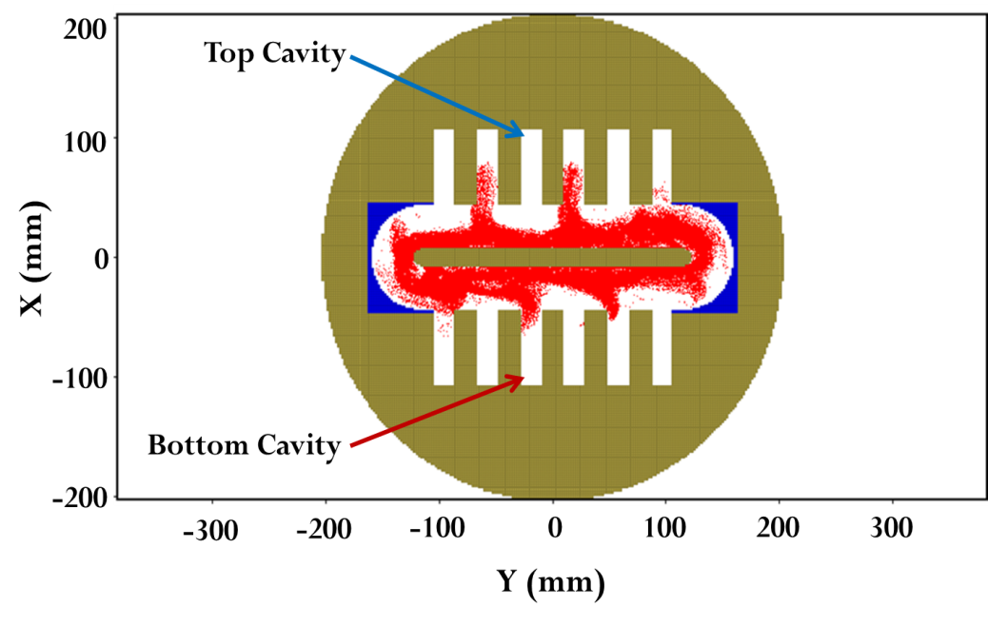
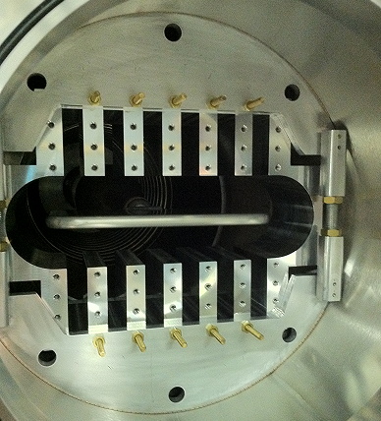
University of Michigan
Relativistic Magnetron Research
Objectives
Explore innovative relativistic magnetrons for HPM generation
Scale to higher microwave power levels
Exploit higher cathode currents
Extend HPM pulselength by lower cathode-anode thermal loading
Increase HPM pulse energy
Recirculating Planar Magnetron: simulation and
Experiment
Approach
Accomplishments & Future
Investigate UM Recirculating Planar Magnetron (RPM) invention (patent pending)
Utilize two linear magnetrons connected by recirculating sections
Large-area cathode for high currents
Scalable to higher powers
Reduce magnetic field volume (V) scaling vs # cavities
Experimentally demonstrated RPM oscillation
Simulations predict Mode-Control-Cathode (MCC) phase-locks linear arrays together
MCC reduces mode competition
Future research will optimize microwave output-coupling techniques

Slide 2
Microwave Oscillation in a Recirculating Planar Magnetron
Matthew Franzi, Ronald M. Gilgenbach, Y.Y. Lau
David Chalenski, David Simon, Geoff Greening
Plasma, Pulsed Power and Microwave Lab, Nuclear Engineering and Radiological Sciences Dept.,
University of Michigan, Ann Arbor
Brad W. Hoff, David French
Air Force Research Laboratory, Directed Energy Directorate, Kirtland AFB, NM
John. W. Luginsland
Air Force Office of Scientific Research, Arlington, VA
Supported by, AFOSR (grant#: FA9550-10-1-0104), AFRL,
L-3 Communications Electron Devices, and Northrop-Grumman
Notes:
<number>

Slide 3
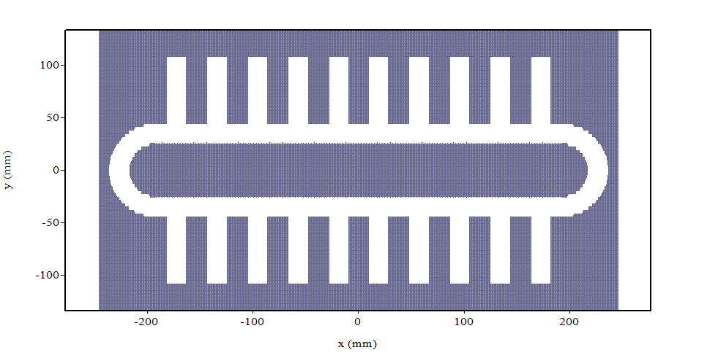
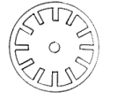
Recirculating Planar Magnetrons1
Motivation: RPM Advantages
Larger cathode surface area provides higher current
Larger anode area allows for faster heat dissipation
RPM allows for nearly full electron beam recirculation
Planar cavities are decoupled from the anode-cathode and spacing
Magnetic field volume (V) scales linearly with # cavities (N) instead of (N2) as with cylindrical magnetron
Cathode
Anode
Conventional-polarity
20-vane RPM
Anode
Cathode
Conventional 12 vane magnetron
1- Patent Pending
Notes:
The primary purpose of the RPM is to exploit a potentially favorable geometric form factor that in turn will provide several operational advantages over a conventional cylindrical magnetron.
Amongst these geometrical advantages are:
Larger cathode surface area for higher current densities than its purely cylindrical counterpart
Larger anode area for faster heat dissipation (especially in CW devices)
The RPM also allows for nearly full electron beam recirculation from one planar oscillator to the other. This intrinsic feedback mechanism not only reduces the complexity of the structure but also exceeds the return efficiency achieved by advanced multistage depressed collectors.
Additionally, the RPM is modularly scaleable. That is to say that each planar oscillator could be indefinitely extended without significantly impacting the operational conditions of the magnetron
This scalability is important as we have been able to show in simulation that the magnetic field volume (denoted as V) scales linearly with RF power as opposed to V2 with a purely cylindrical device. An advantage that may be easily exploited with additional cavities and extraction waveguides.
<number>

Slide 4
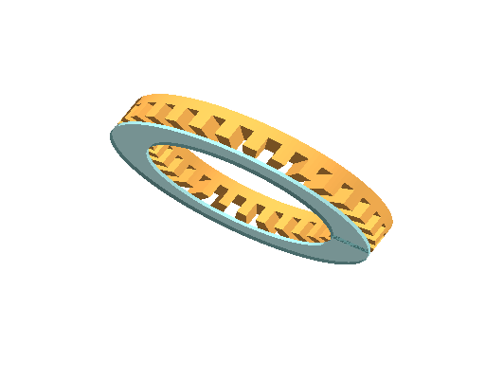
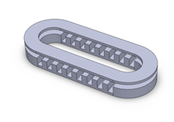
Recirculating Planar Magnetrons
Motivation-RPM Embodiments
1
2
3
r
z
z
x
y
r
z
Radial magnetic field (r)
Axial electric field between anode and cathode (Z)
ExB drift (θ)
Cylindrical cavity array
Radial magnetic field (r)
Axial electric field between anode and cathode (Z)
ExB drift ~(θ)
Planar cavity array
Axial magnetic field (z)
Electric field between anode and cathode (x)
ExB drift ~(y)
Planar cavity array
Notes:
The original concept of this device manifested itself in three primary embodiments including :
Two radial magnetic field configurations, shown here as embodiment 1 on the left (which contains an axial electric field with an azimuthal cavity array)
And embodiment 2 shown “here” which again utilizes and axial electric field but instead uses a purely planar slow wave structure
The third embodiment, which we have shown on the previous slide, is an axial B device (similar in concept to a conventional magnetron) where by a pulsed voltage is applied to the central cathode “here”. The resultant cross field configuration, if properly tuned, allows for a synchronous transverse drift velocity of the emitted electron beam with each planar slow wave structure. **Due to its operational similarity with the conventional magnetron” It is this 3rd embodiment which we have elected to research at the UM and will be our focus for the remainder of this presentation.
<number>

Slide 5
Recirculating Planar Magnetrons
Design Parameters
Model: RPM-12A
Design:
12 Cavities- 2 planar oscillators
6 cavities each
Operating Frequency:1 GHz
π-mode Guided Wavelength: 7.69 cm
Phase Velocity: 0.26c
3.85 cm
6.3 cm
4.45 cm
2.54 cm
Notes:
Using a great deal of analytic theory and simulated modeling we were able to design, construct, and install our first RPM prototype at the UM.
This prototype, which we have aptly named the RPM-12a, is a L-band
12 cavity magnetron composed of 2 , 6 cavity planar oscillators.
We designed this first model to roughly match our previous A6 relativistic magnetron which operated in pi-mode at ~1GHz with a phase velocity of ~0.25*c
<number>

Slide 6
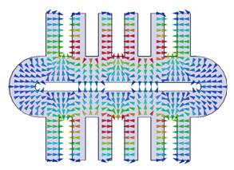
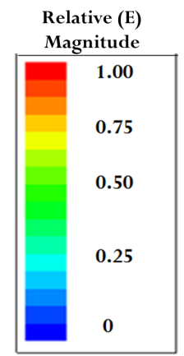
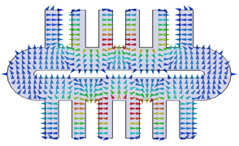
Recirculating Planar Magnetrons
Simulated Results: Even-Odd modes HFSS
Even π-mode 1.011 GHz
Closely spaced mode structure
Same planar guided wavelength
  λg = 7.68 cm
~3Mhz separation
Odd π-mode 1.008 GHz
Notes:
Our study of this device beings with an analysis of the cold tube dispersion relation. Using the finite element solver HFSS we were able to perform a simple sweep of eigenmode solutions with respect to frequency and then correlate these solutions to specific operating modes through their unique electromagnetic field configuration.
Shown here is an example of the pi-mode eigen solution where by a 180 or pi radian phase shift exists between adjacent cavities.
One of the interesting properties we discovered with this preliminary analysis was the existence of a bifurcated mode structure. The two fold symmetry of the slow wave structure necessitates a unique BC along the horizontal plane of symmetry producing two distinct sets of classic planar operating modes.
We have designated these sets as:
Even modes with a 0 degree phase shift between symmetric cavities on the top and bottom
and Odd modes with 180 degree phase shift
<number>

Slide 7
Recirculating Planar Magnetrons
Experimental: Cold Test
1: π-even
2: π-odd
3: 5π/6-even
4: 5π/6-odd
3
2
4
1
Notes:
We were able to experimentally validate the existence of this unique mode structure experimentally using a dipole antenna in conjunction with a network analyzer in close proximity to the planar cavity array.
Shown here is a 50 MHz sample of our resultant single port S-parameter for frequencies between 0.97GHz and 1.02 GHz. The four distinct resonances we were able to identify, using our results from HFSS, as the even/odd pi and 5pi/6 modes by.
<number>

Slide 8
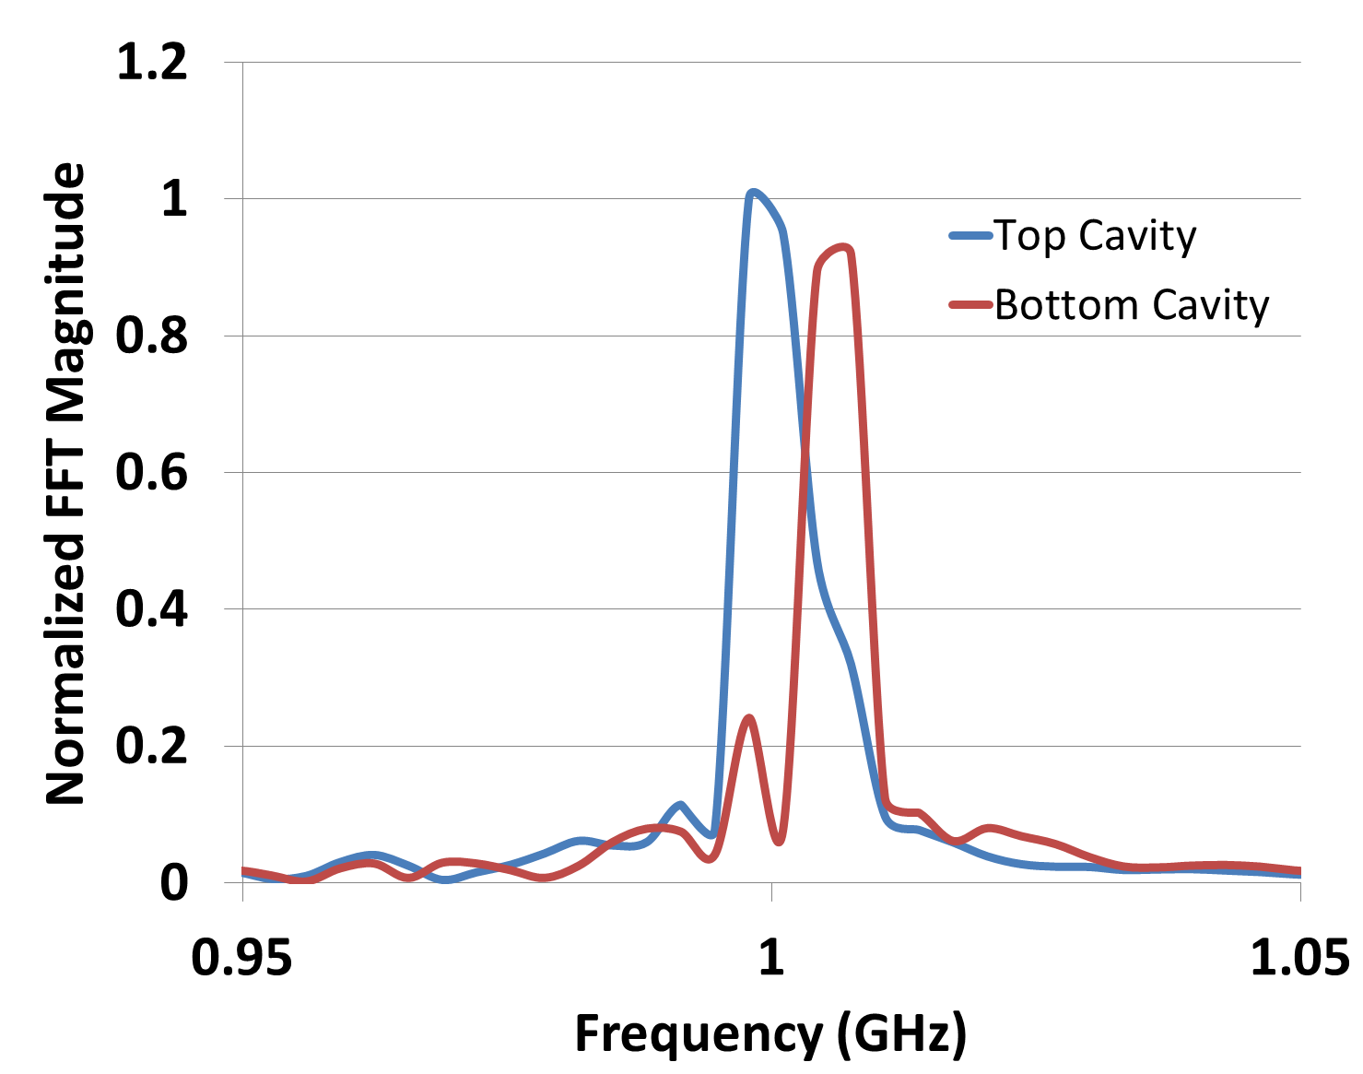
Recirculating Planar Magnetrons
Simulated Results: Operating Modes
Top and bottom oscillator operate in π-mode
Each side operates at an offset frequency
  8 MHz separation
  Slight competition
Notes:
Using our cold test dispersion as a reference we were able to perform fully 3D hot tests using the PIC code MAGIC in order to obtain beam loaded operating modes of the RPM-12a.
The simulation shown in the upper right is a quintessential example of pi-mode operation where in an electron spoke formation exists in every other cavity for both the top and bottom oscillator.
We further our analysis of this operating mode by observing the oscillatory voltage signal across a single cavity on both the top oscillator (shown in blue) and the parallel cavity of the bottom oscillator (denoted by the red arrow). We then perform a time integrated FFT over the 300 ns simulation to obtain the dominate operating frequency.
What we found is that not only are the two oscillators operating in slightly offset frequencies (approximately 8 MHz apart) but there is also some margin of mode internal mode competition due to the existence of these two distinct pi-modes (indicated by the slight double peak on the bottom oscillator)
<number>

Slide 9
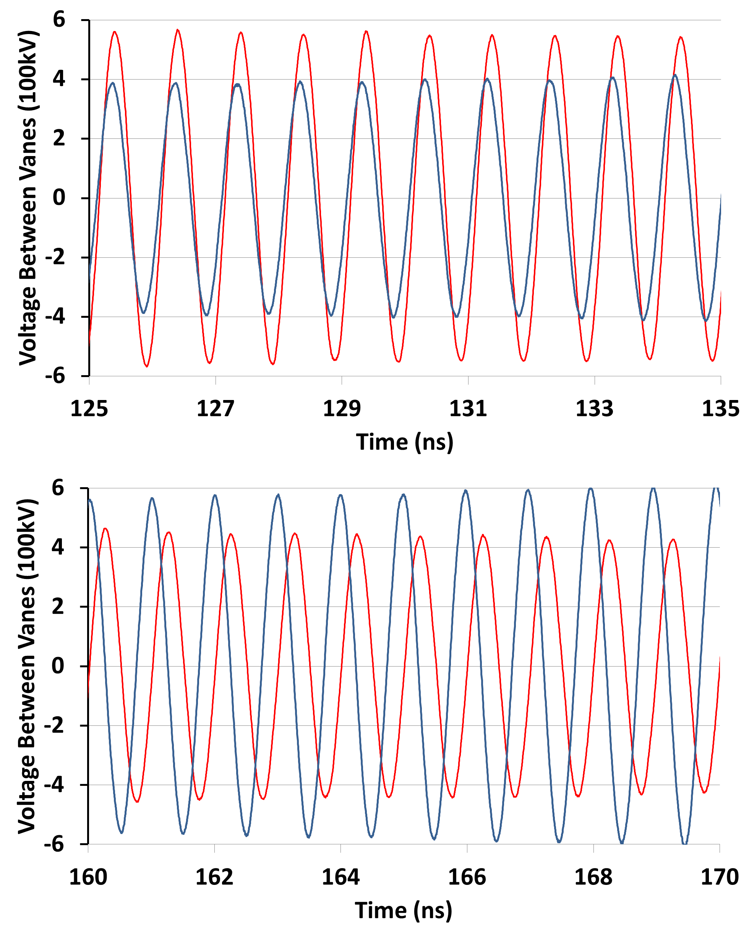
Recirculating Planar Magnetrons
Simulated Results: Cavity Signals
30 ns later
Oscillator voltage signal of symmetric cavities
Phase drifting
  Slightly offset π-mode
  Drifts from in phase to out of phase in 40 ns
Notes:
These offset pi-modes not only lead to competition and mode degradation during operation but may also may adversely affect the coherency of the RF power at the output of the device due to drifting phase differences between oscillators.
This phenomenon is exemplified by the signals shown here which are samples of the cavity voltage signal shown on our previous slide at two segments in time spaced 30 ns apart. As you can see, we move from in phase on the left at approximately 125 ns to entirely out of phase at 165ns.
From here we move into our preliminary RPM experiment at the UM where it is our ultimate goal to be able to observe, diagnose, and remedy this problem in a physical environment.
<number>

Slide 10
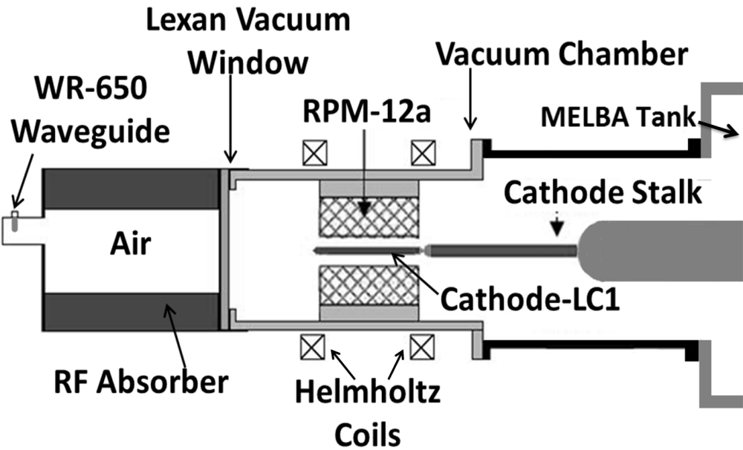
Recirculating Planar Magnetrons
Experiment (Equipment Diagram)
Notes:
Shown here is axially oriented cross section of our experimental setup. Following this structure from right to left we have our MELBA which provides a -300kV pulsed voltage to the coaxial transmission line.
The pulse tranverses the transmission line which terminates in the emission primed cathode structure which is centrally located about the RPM-12a anode block. An axially uniform magnetic field is applied by via the helmholz electromagnet configuration providing the necessary cross field configuration for our drifting electron beam.
RF power that is generated in the open face cavities of the RPM slow wave structure is then able to weakly mode convert to a cylindrical waveguide mode within the vacuum chamber itself. Power from the vacuum chamber propagates into atmosphere through a electromagnetically transparent Lexan window to the load chamber lined with an RF absorbing dielectric. We sample a small amount of the remaining power through a WR650 to type N antenna to diagnose the frequency and relative timing of our HPM pulse.
<number>

Slide 11
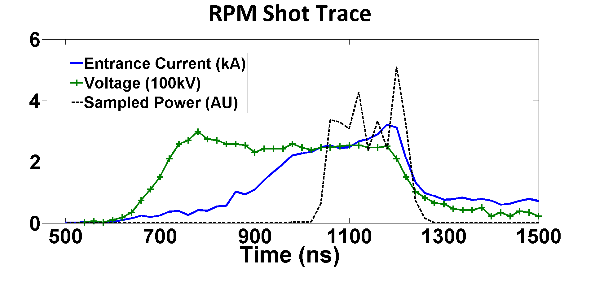
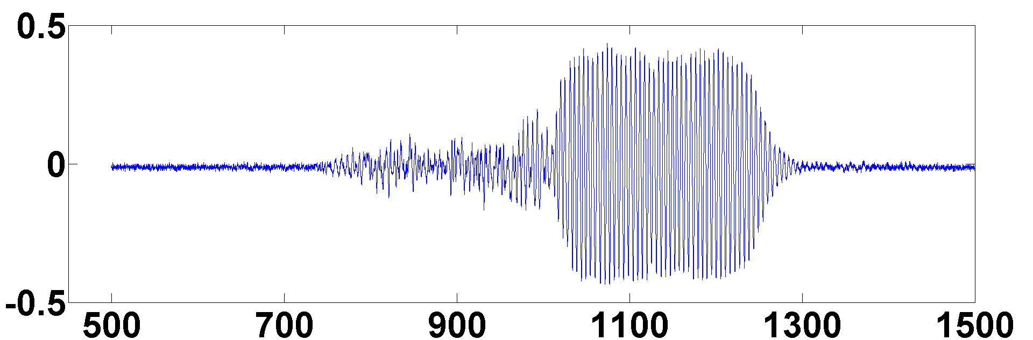
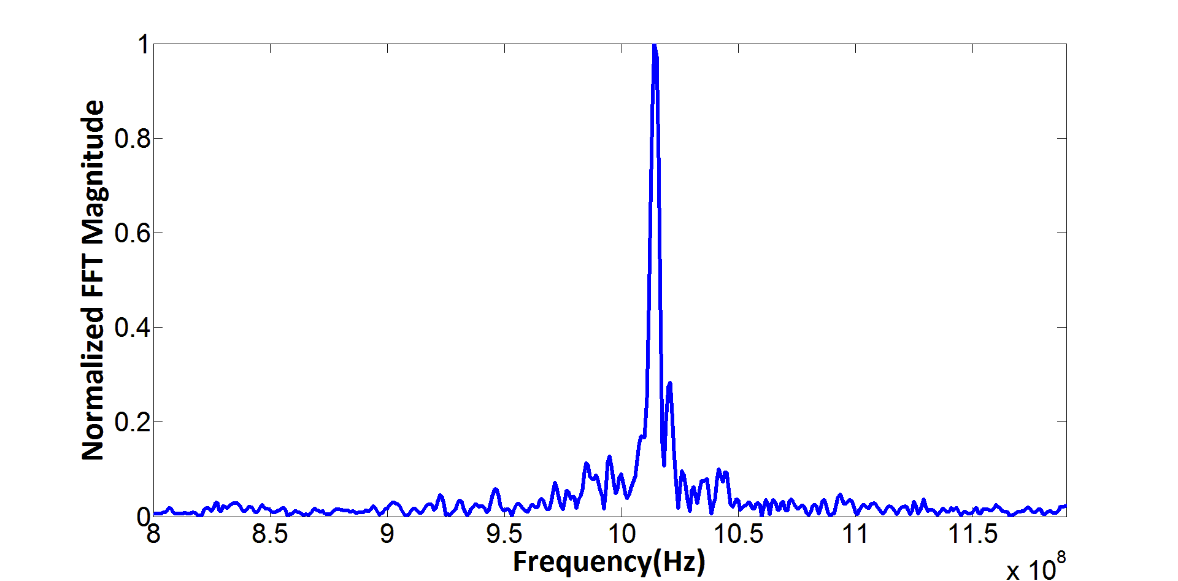
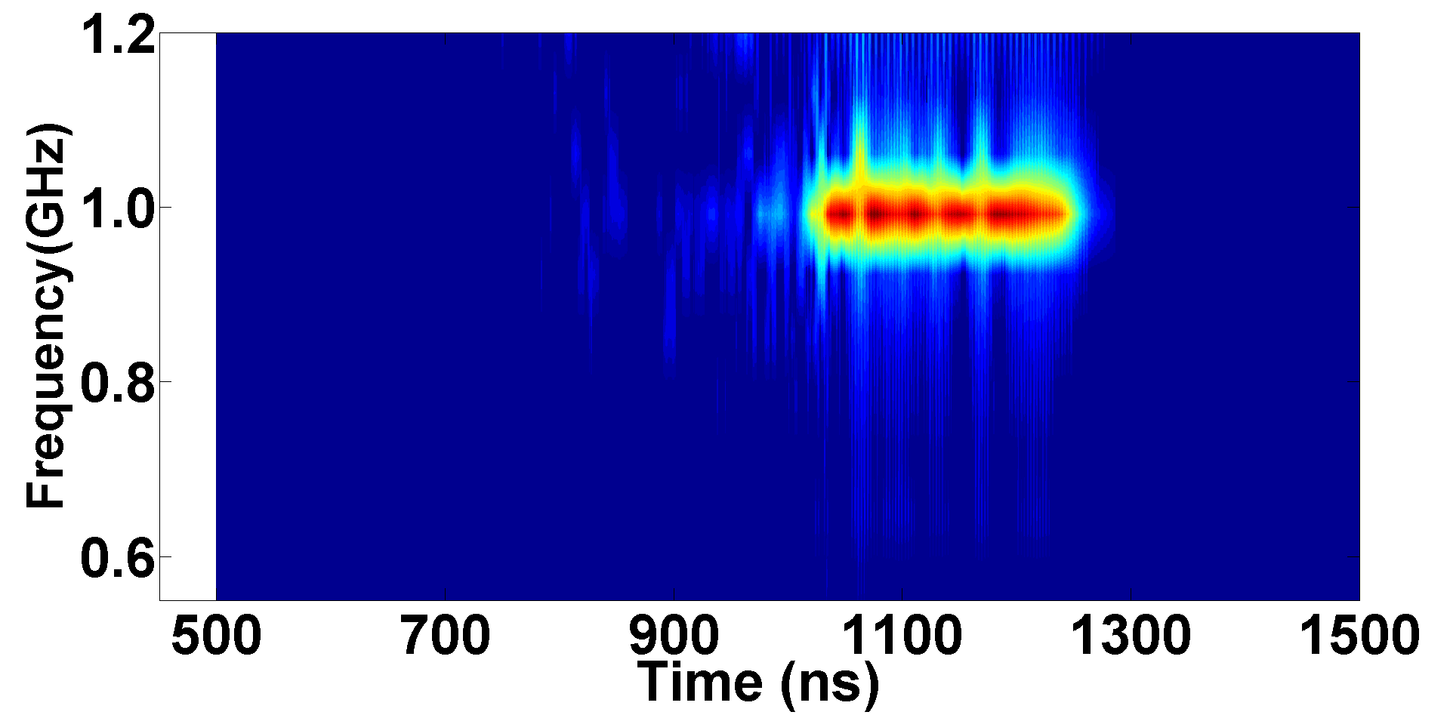
RPM Shot 13111
Axial Magnetic Field: 0.20 T
Microwave Pulse Length: ~250ns
Oscillation Frequency: 1.015GHz
Anticipated Mode: π-even
Current at Startup: 2.35kA
Peak Current: 3.3kA
Heterodyne(V)
Notes:
Here is a typical shot summary for pi-mode operation of the RPM-12a. In the upper left we have the shot profile with voltage in green, total emitted current in blue, and our sampled power in black (which we again use for frequency and timing purposes).
We analyze frequency using a heterodyne diagnostic for which the raw data is shown here and then apply a moving window FFT as well as a time integrated FFT to provide frequency v time as well as the dominate frequency throughout the pulse.
Using a -250 kV applied Voltage and a 0.2 T axial magnetic field this particular shot predominantly produced microwaves at 1.015GHz for approximately 250 ns.
Despite having several shots which display ideal profiles with long uniform pulses, the RPM is highly susceptible to competition due the closely spaced mode structure I described earlier.
<number>

Slide 12
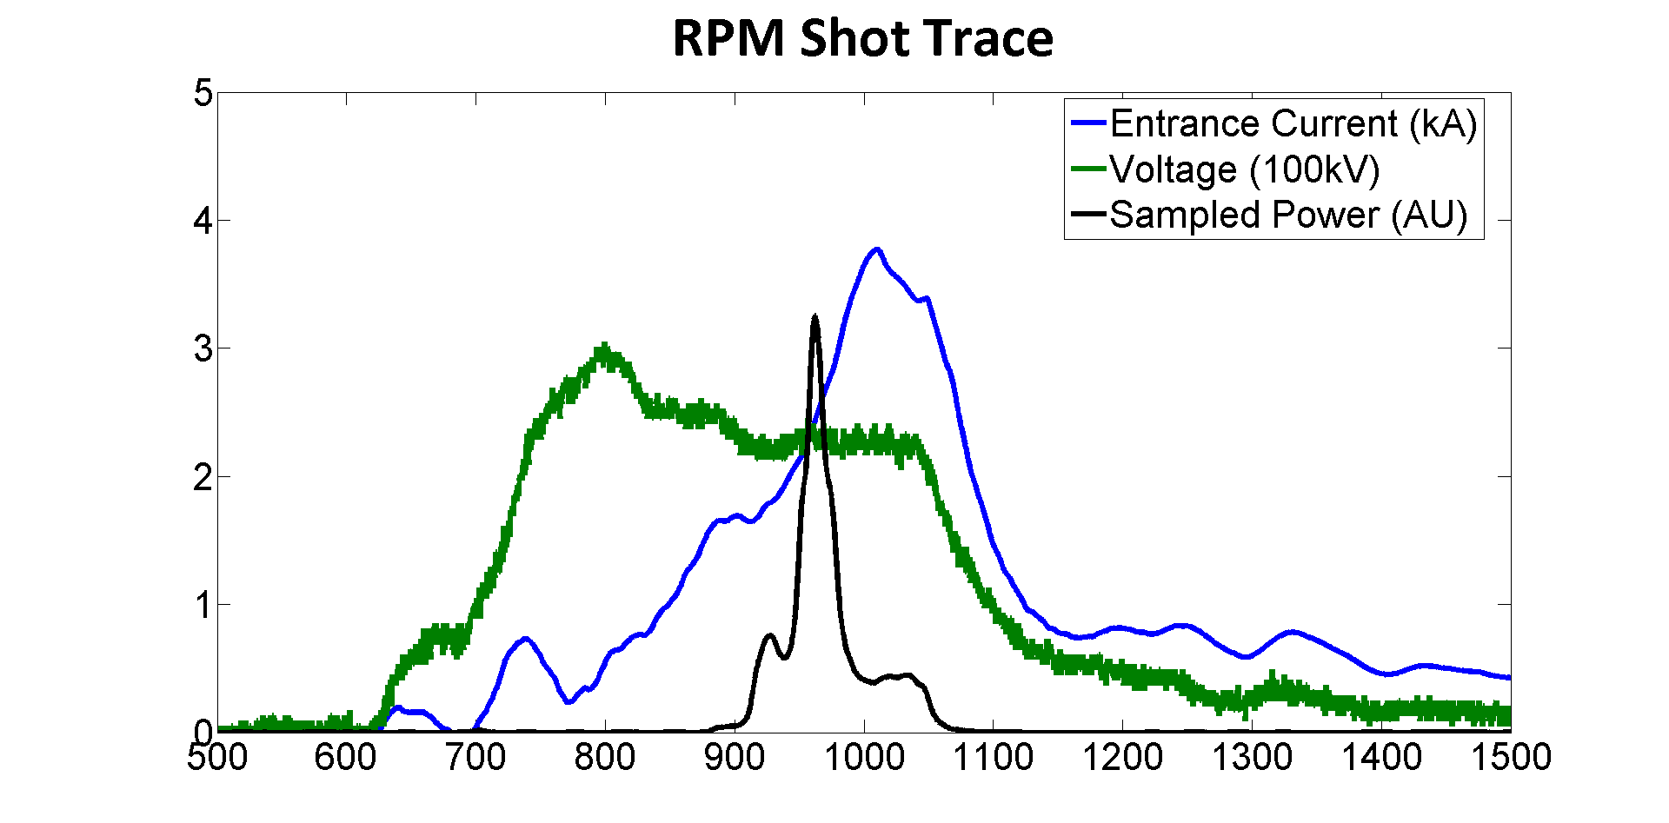
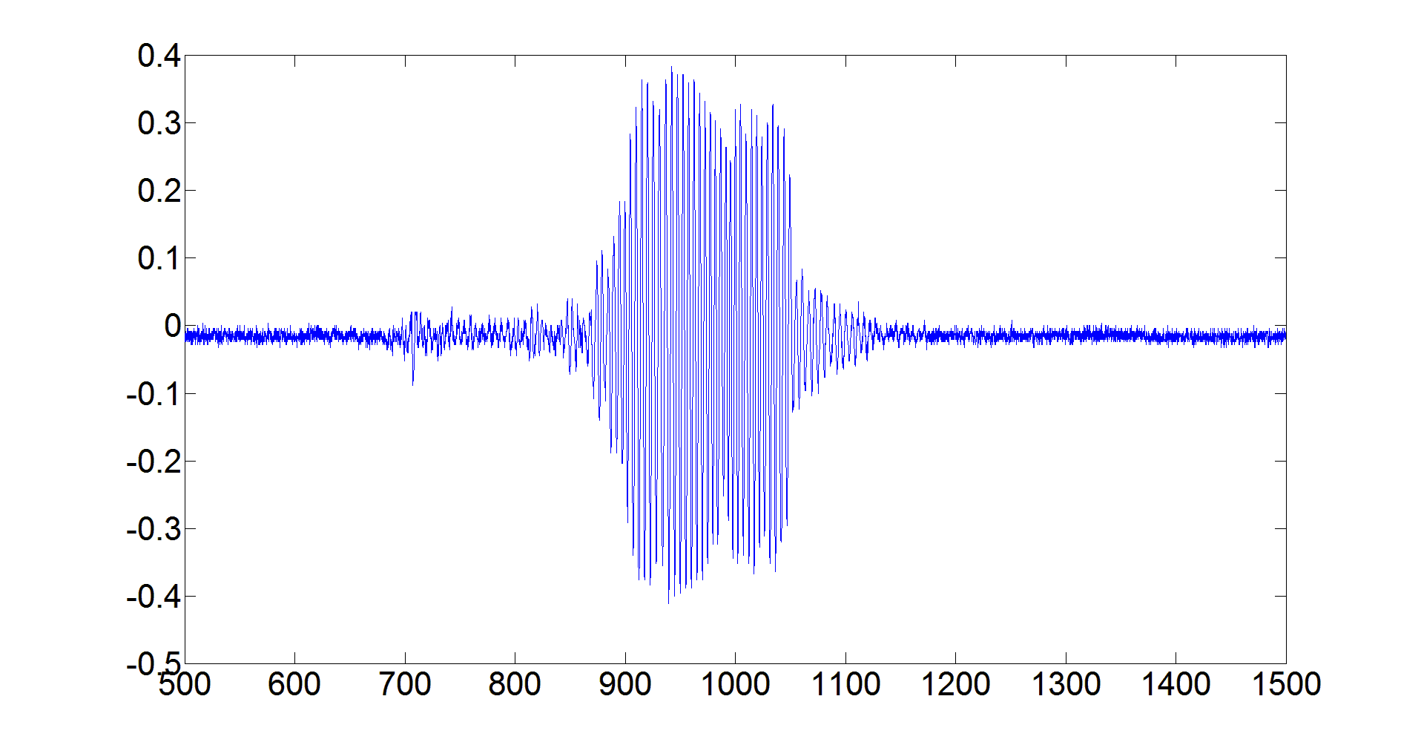
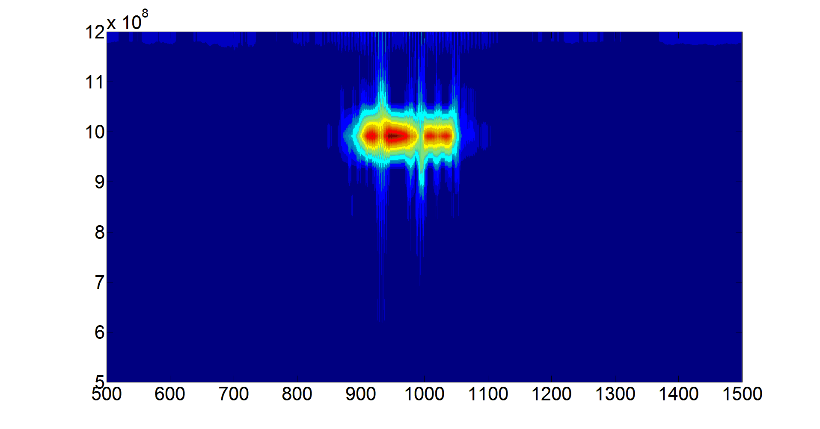
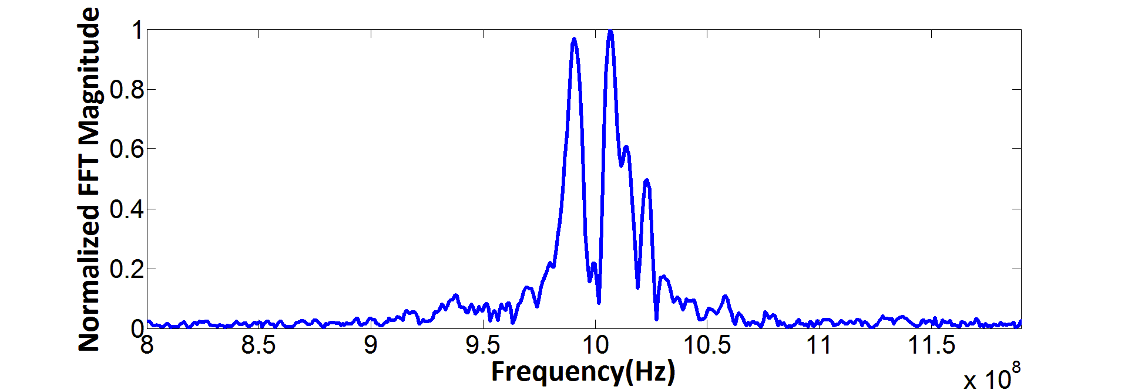
RPM Shot 13117
Axial Magnetic Field: 0.18T
Microwave Pulse Length: ~200ns
Oscillation Frequency:
1.01GHz
0.99GHz
Anticipated Mode: Bimodal
Current at Startup: 1.7kA
Peak Current: 3.9kA
Heterodyne(V)
Frequency(Hz)
Time (ns)
Notes:
This shot, run using nearly identical applied fields, yielded a sharply rising diode current which consequently provided dynamic operating conditions within the device. As a result the RF mode suffered from severe competition between several RF frequencies (most notably 1.01GHz ~pi and 0.98 ~5pi/6)
The output HPM pulse was not only shorter in duration but also experienced mode hopping and regions of almost no sampled power during the 200ns period.
<number>

Slide 13
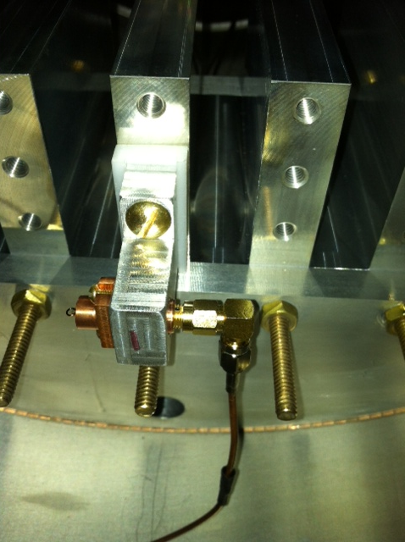
Recirculating Planar Magnetrons
Experimental Results: B-dot probes
Experimental Frequency and Phase Measurements
2 B-dot probes placed near symmetric cavities of the RPM
Oriented to diagnose fringing H-field from cavity
  ~3.8 cm away from cavity
  ~0.2 cm2 area
Notes:
Once confident in our ability to readily produce microwaves we evolved our diagnostics a bit and implemented B-dot loops in the vicinity of the open face of the RPM cavities.
Currently we have employed two b-dots within our experimental prototype, one on each oscillator. We have oriented these loops such that we can observe the frequency and phase of the fringing magnetic field of each cavity in a manner similar to the diagnostics we observed in our simulated system.
<number>

Slide 14
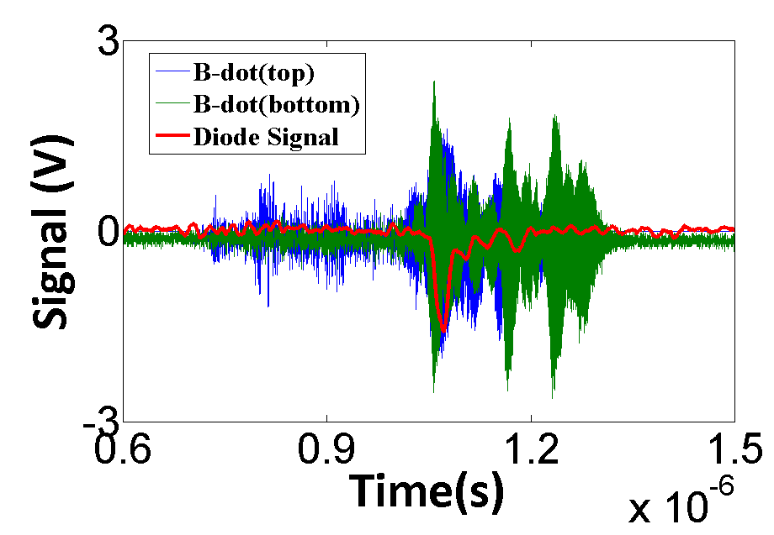
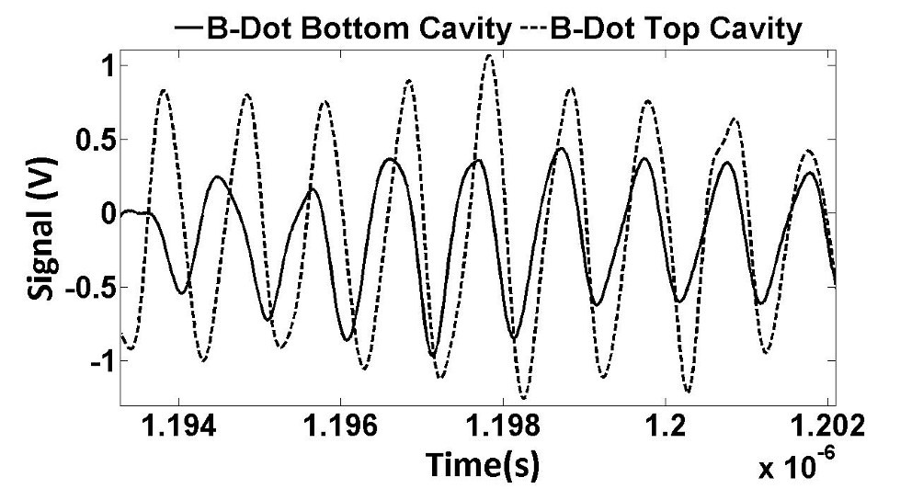
Recirculating Planar Magnetrons
Experimental Results: B-dot probes
Primary Frequency:
0.989 GHz
Microwave Oscillations measure by b-dots extend past diode signal
Phase drift and offsets (between oscillators) exist throughout pulse duration
Notes:
The plot in the upper right shows the super imposed signal from each B-dot loop as well as the our original diode sampled power signal as a function of time.
The two primary observations to make with this particular data set is
One: that the signal from both B-dots extend far past the diode signal (indicating that evolution of an RF block between the two diagnostics which we believed is caused by plasma formation on our lexan vaccum window)
and Two :that the oscillating H-field from parallel cavities exhibits the same phase drifting which we identified in our simulated unlocked oscillators.
To improve the potential for our oscillators to achieve locking we considered several possible solutions including vane strapping, gap coupling resonant cavities, and continuous slow wave structures to maintain proper RF bunching about the device.
What we found actually worked best was to not alter the anode at all but instead focus on cross oscillator communication through the cathode.
<number>

Slide 15
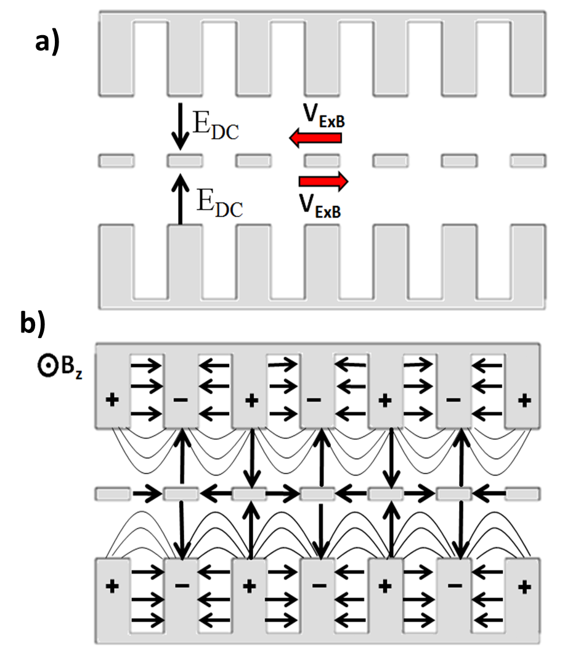
Recirculating Planar Magnetrons
Simulated Results: MCC Concept
Mode Control Cathode
  Geometrically similar to Transparent Cathode (Schamiloglu et al. )
  Emission priming structure
  Acts as a resonant electromagnetic coupler
  Full electron circulation
  Cross oscillator self focusing
  Independent tuning mechanism
x
y
z
Notes:
With that we present the Mode Control Cathode
Geometrically similar to the transparent cathode developed by Prof. Sgu at the UNM,
The MCC will act as an emission priming structure for both the pi and 2pi modes.
However, instead of acting to enhance the electrostatic field on the surface of the cathode, the MCC works to resonantly couple RF fields from one side of the device to the other.
The periodically slotted structure also provides full electron beam circulation throughout the entirety of the planar geometry and may lead to a phenomenon we refer to as “Cross Oscillator Self Focusing” which I will elaborate on shortly.
Additionally the MCC can be utilized as an RF tuning mechanism that is completely independent from the surrounding slow wave structure. Subtle changes to the size and shape of each periodic structure can be analytically shown to shift the frequency of a given mode or increase mode separation (particularly between the closely spaced even-odd modes I identified initially.)
<number>

Slide 16
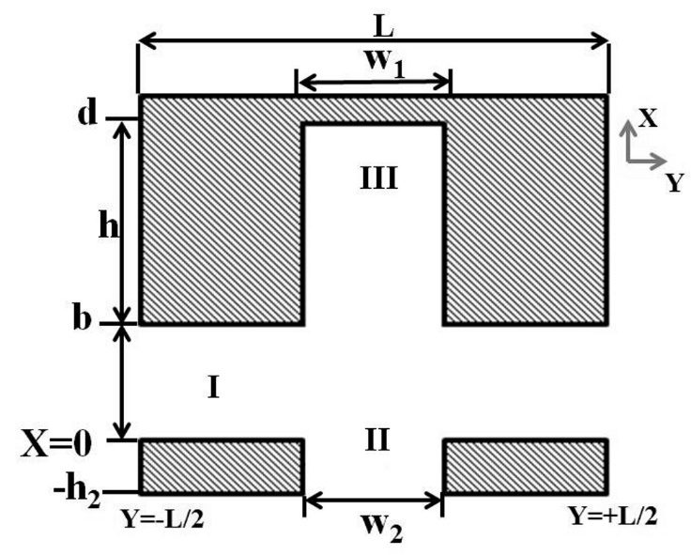
Recirculating Planar Magnetrons
Simulated Results: MCC Concept
Boundary Conditions:
Phase Shift per Cavity
Even Mode Dispersion Solution: UV=-YZ
Propagation Constants:
βn= β0+2πn/L
Notes:
The cold tube dispersion relation may be solved for analytically by first assuming an infinite array of planar cavities . We then simplify this infinite array into a single modular cavity by assuming a periodic boundary condition with a constant phase shift from Y=-L/2 to Y=L/2.
The resonant frequency is found by matching the impedance of the RF wave at both boundary at the cathode interface (I-II) as well as the cavity interface (I-III).
The solution for which is shown here for the even mode set.
By sweeping the phase shift /cav we can identify our full dispersion relation for either the even mode, using a symmetry boundary at X=-h2 or the odd mode, using a null boundary condition at X=-h2.
<number>

Slide 17
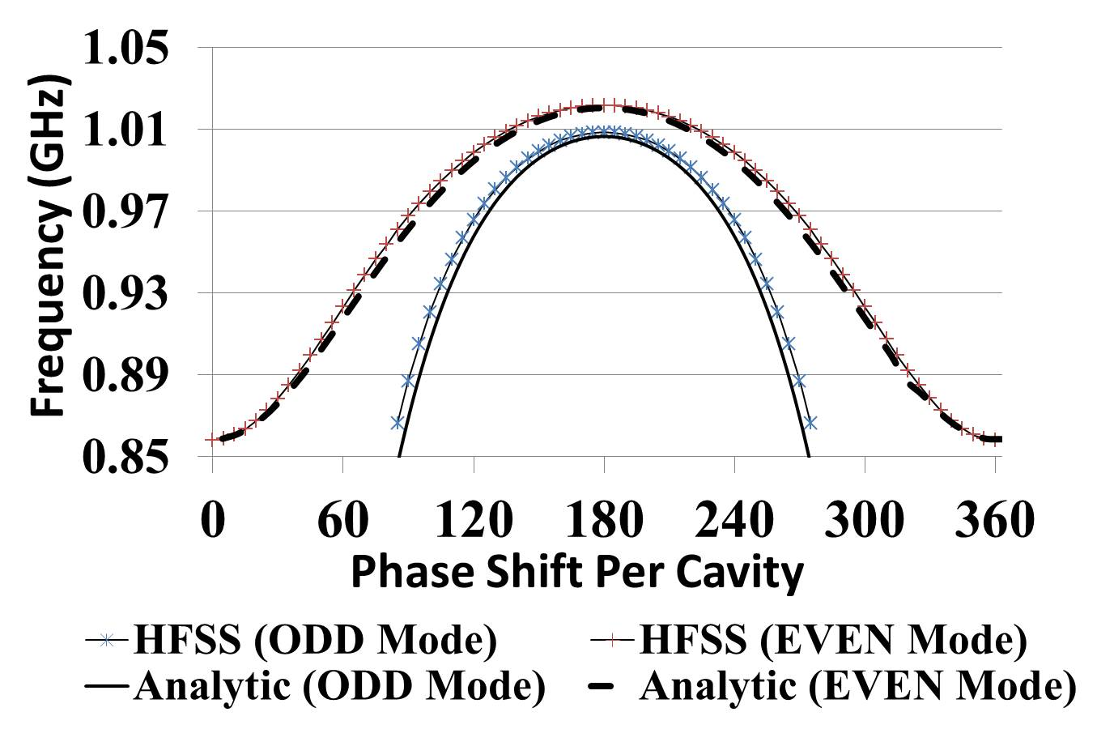
Recirculating Planar Magnetrons
Simulated Results: MCC (Analytic Versus HFSS)
h1= 6.3 cm
b=2.4 cm
h2=0.75 cm
w1=1.92 cm
w2=1.92 cm
Notes:
Using this single modular cavity geometry in HFSS we performed a similar sweep of th planar propagation constant and plotted the resultant frequencies of each mode for both the even-odd mode soltions.
As shown from the plot the two models show very good agreement. This particular example is modelled to reflect our RPM-12a geometry and as such is not fully optimized to maximize mode separation. Our analytic model predicts that the even and odd mode separation may exceed 100 Mhz with proper tuning of the MCC and AK gap.
<number>

Slide 18
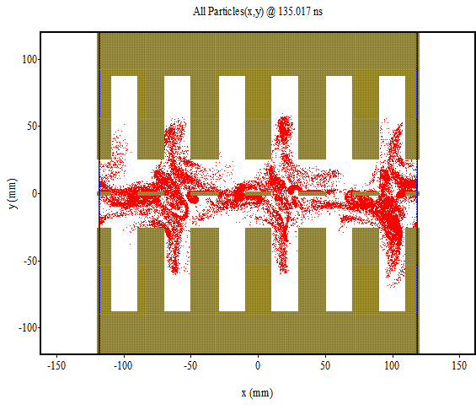
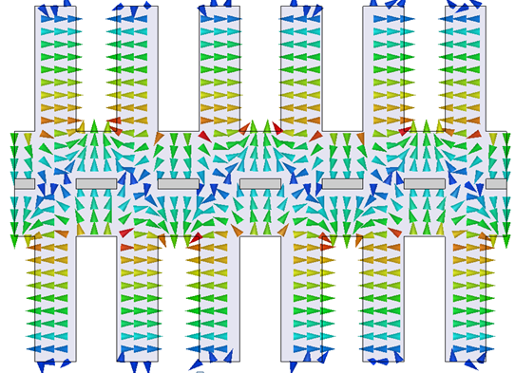

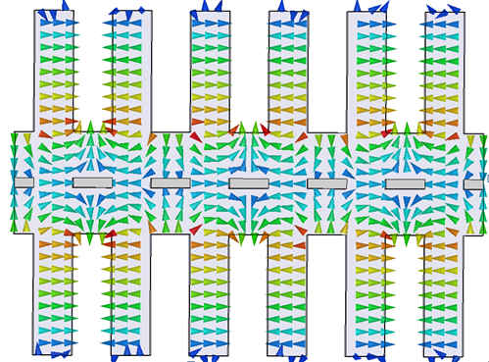
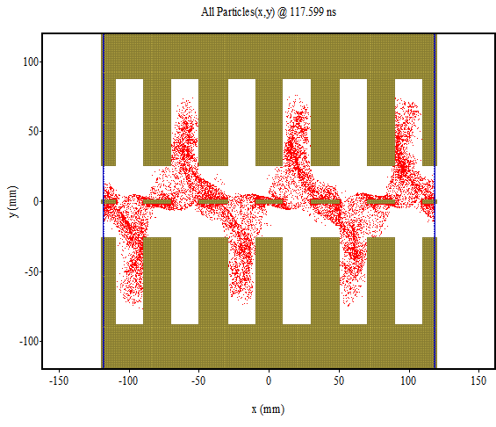
Recirculating Planar Magnetrons
Simulated Results: MCC in 2D PIC
Odd π-mode
Even π-mode
Notes:
Going back to our PIC code we use a 2D re-entrant planar magnetron modled in MAGIC to perform a basic feasibility study of phase locking between the two now strongly coupled oscillators.
In this slide the RF electric field configuration on the left corresponds to the post start up pi-mode spoke formation on the right. It is interesting to note that the out of phase odd mode E fields produce an ExB drift in the opposite direction leading to in phase spoke formations, which the even mode E fields produce an ExB drift in the same direction yielding the out of phase spoke formtions shown here.
It is this mono-directional ExB drift where in both cavities contribute to a single spoke formation that we refer to as cross oscillator self focusing and believe will significantly assist in both start up and locking.
<number>

Slide 19
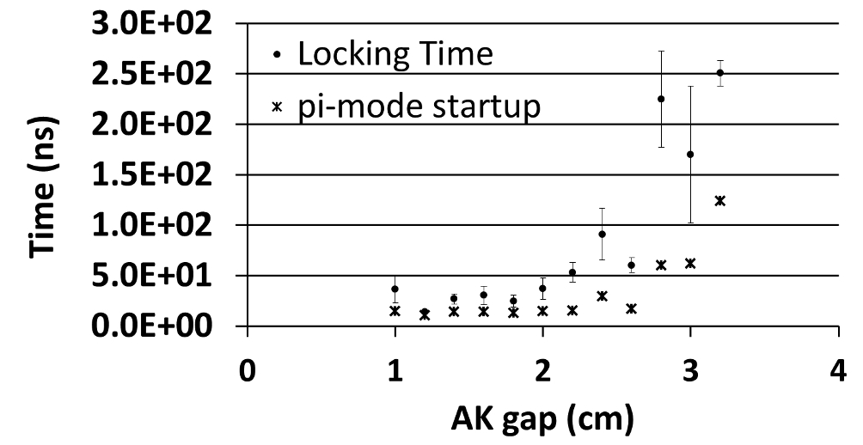
Recirculating Planar Magnetrons
Simulated Results: MCC in 2D PIC
Simulations reached a locked state when the relative phase between top and bottom cavities did not vary mode than +- 2 degrees for 50+ ns
MAGIC PIC Results:
Re-entrant boundary conditions
0.18 T applied magnetic field
Applied voltage varied from 150 to 500 kV depending on AK gap
Phase locking occurred in as little as 28 ns for small AK gaps
Notes:
Assuming the oscillators are locked when their relative phase does note vary more that 2 degrees for a duration of 50 ns, we tracked both start up and locking time as a function of the simulated AK gap.
We found that the smaller AK gaps, which intuitively correlate to higher fringing fields from each cavity reaching the cathode resulted in improved coupling between the two oscillators.
Ultimately we were able to demonstrate that with proper tuning of the RPM geometry both startup and locking could occur in as little as 30 ns, approximately half the time it would take for simply start up with a solid cathode.
<number>

Slide 20
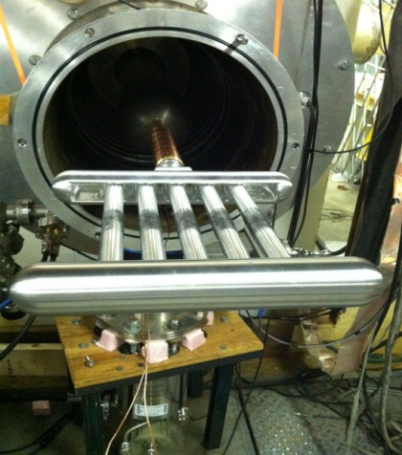
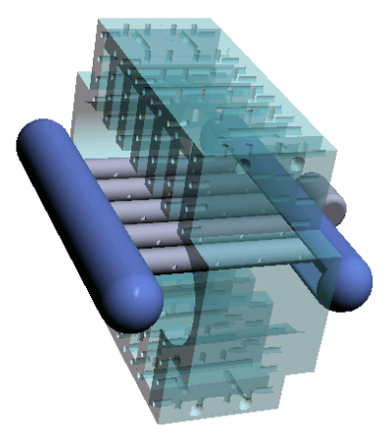
Recirculating Planar Magnetrons
Recent Work: Mode Control Cathode
Experimental MCC
  5 periodically spaced 2.2cm OD rods
  3.8 cm apart (matching vane-cavity spacing)
  3.34cm AK gap
  Phase locking is evident in some cases
Notes:
We have recently adapted our theoretical MCC design to our experimental RPM. Our Prototype MCC consists of 5 periodically spaced aluminum rods bounded by cylindrical end hats to mitigate parasitic endloss current.
Each of these rods are 2.2cm in OD, producing an AK gap of 3.34cm. Additionally they are spaced 3.8 cm apart such that they are aligned each vane of the RPM-12a anode block
It should be noted that the MCC prototype was a model adapted for our current experimental setup and as such some parameters, including the AK gap, are toward the outside of our range of simulated viability.
Our results using the MCC to date are largely inconclusive. In many cases the RPM failed to produce consistent uniform HPM pulses for durations long enough to satisfy the locking time criteria.
<number>

Slide 21
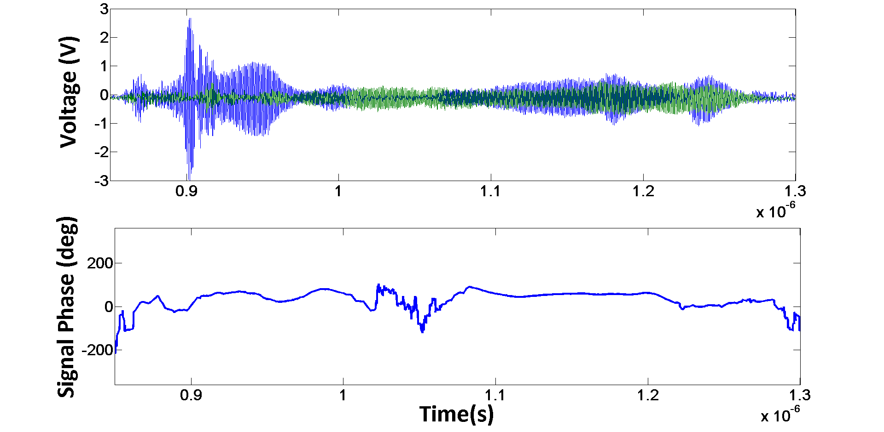
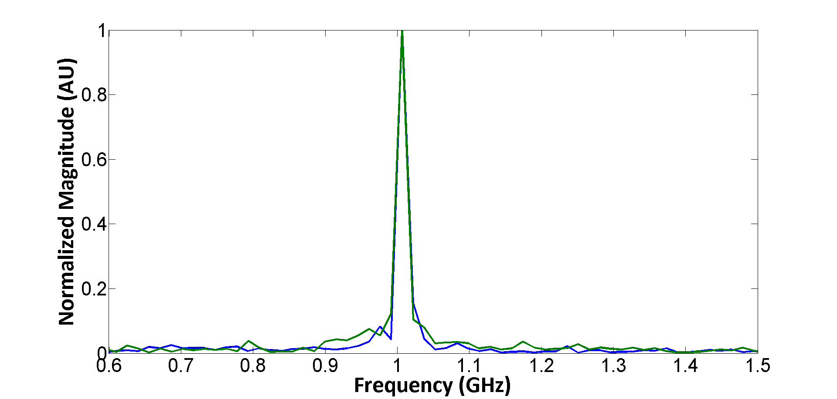
Recirculating Planar Magnetrons
Recent Work: Mode Control Cathode
Top B-dot
Bottom B-dot
π-mode – Raw Data
π-mode – FFT
Locked π-mode
Notes:
With that being said we have observed some promising results on a case by case basis. Many of our pulses exceeding 200 ns experienced brief periods of phase locking, towards the end of the pulse that were previously unachievable using a solid cathode.
Shown here is an example profile where by the RPM hoped into a locked pi-mode state right before the pulse was command shorted.
We are able to diagnose locking by measuring the relative phase difference as a function of time and identifying periods of minimal phase drifting. Taking an FFT over this localize locking period allows us to confirm that oscillators are operating at the same frequency and phase.
In the near future we hope to design an RPM/MCC structure that is more aptly suited to produce locking given our operational capabilities.
<number>

Slide 22
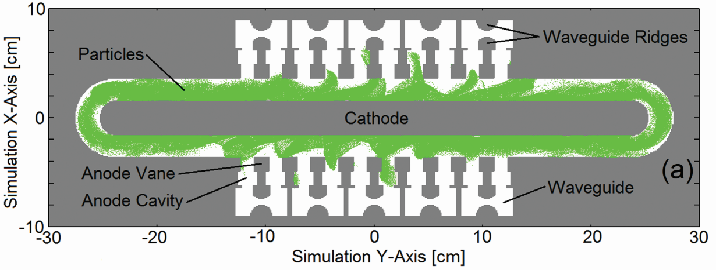
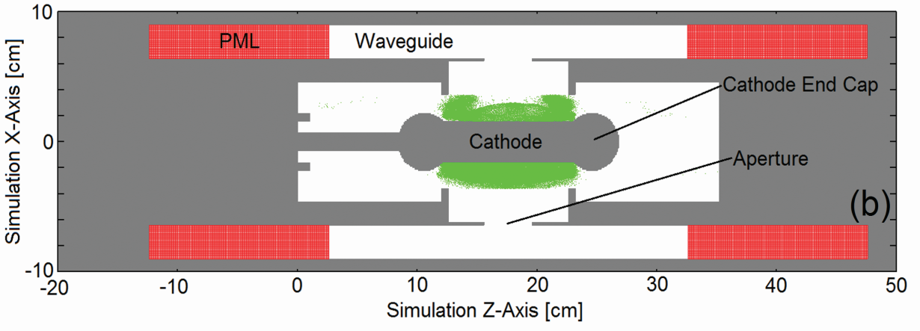
Recirculating Planar Magnetrons
Future Work: Axial Extraction
Axial Extraction (Hoff et. al)
Based off the slotted waveguide antenna [greenwood patent]
Ridged waveguides allow for smaller guided wavelengths and higher efficiency.
Pulsed Bias : 300kV
Axial Magnetic Field: 0.13T
Diode Current: 3kA
Operating Frequency: 2.2GHz
Output power: 400MW
Efficiency: 45%
Notes:
In conjunction with adapting the RPM for phase locking, we also hope to design and build a guided extraction scheme for the RPM in order to accurately obtain power and efficiency measurements.
One of the most viable approaches we are currently considering is an adaptation of the all cavity extractor developed by Dr. Greenwood.
A version of this design, which is being tailored to the RPM by Dr. Hoff at the AFRL, is shown here.
In this model ridged waveguides are implemented to reduce not only the width of each extractor waveguide but also allow for a reduced guided wavelength and RF phase velocity in the system (which ultimately we believe will enhance efficiency).
This model was simulated to run in S-Band at 2.2 GHz using our experimental viable applied fields at -300kV and 0.13T. The design was able to produce approximately 400 MW at 45% efficiency.
While we are not anticipating these designs to translate perfectly from simulation to experiment we are very excited regarding the prospect of some of these results.
<number>

Slide 23
Recirculating Planar Magnetrons
Conclusions
RPM experiments are currently underway at UM on MELBA @ -300 kV, 1-10 kA, 0.2-0.7 microsecond, 0.18-0.22T
~100 recorded shots with observed microwave oscillation in the vicinity of π-mode frequencies were measured (0.97-1.01 GHz )
  50-300ns microwave pulse length
  2-10kA emitted beam current
  B-dot probes validated frequency/phase
Mode Control Cathode has been shown, in simulation, to:
  Increase cross-oscillator communication
  Support phase locking
  Increase mode separation
  Reduce start-oscillation time
Experiments on the Mode Control Cathode are underway
Notes:
<number>

Slide 24
Recirculating Planar Magnetrons
Future Work: Objectives
Finish parameter sweeps of magnetic field for the MCC
  B-dot probes will diagnose locking between oscillators
Adapt RPM slow wave structure and MCC design to optimize theoretical locking criteria
  Smaller AK-gap
  Rectangular cross section for MCC rods
Extraction system design and fabrication are anticipated for Spring/Summer 2013
Notes:
<number>

